Slide 1


Department of Information Science and Engineering
Department of Information Science and Engineering
FINAL YEAR INTERNSHIP PRESENTATION BY:-
N VISHWAS 1NT19IS087
28/12/2022

Slide 2
Contents
Introduction
About Company
Work Carried Out
Conclusion

Slide 3
Introduction
This internship is actually a web development internship. The objective of this internship is to train students on various web development tools and technologies and help them make their own Web development Project .
The Project consists of two parts front-end and back-end development. The front-end is the part of the web that you can see and interact with (e.g. Client-side programming). While front-end code interacts with the user in real time, the back-end interacts with a server to return user ready results. The front-end is a combination of HTML,CSS and JavaScript coding. By using JavaScript, modifications of the design of a web page can be made immediately, however only temporary and visible only by the user. Normally the user would not have rights to modify web content dynamically on the server side.

Slide 4
Introduction
Logically, administrators are the ones who deal with back-end modification of databases for example, as they often contain sensitive data which should not be available to see or modify by the general public. Back-end programming languages include PHP, Java, Python, Ruby and others. I focused on both front hand as well as back end development in order to create a standalone application by myself. Difference between front end and back end development is shown in below figure.

Slide 5
Introduction

Slide 6
About Company
Yayati Consulting LLC is a website development and digital marketing partner for small and medium businesses. We craft a unique experience for your customers that outsells and outshines your competition online.
The curve of adoption of technology isn’t that exponential as the curve of development of technology. We are doing our bit in helping small and medium businesses adopt the latest and more optimized solutions.

Slide 7
About Company
They provide sterling services that far exceed global standards at a competitive range:
Web Development
Custom Software

Slide 8
Work carried out
During the time span ,was part of the Full Stack Development team
In the initial days worked on the front end development and backend of the company’s sample website.
Currently part of the team which develops the clients project.

Slide 9
Work carried out
Many actions a developer performs daily require skills like JavaScript or HTML coding, with a great deal of overlap in their day-to-day responsibilities. In this tutorial, we will explain the various tools and technologies these professionals use in their everyday work, as well as the skills needed to be successful in the field.
A full stack developer has one general responsibility: to ensure that website visitors can easily interact with the page and also ensure proactive functioning of the server side code and database operations. They do this through the combination of design, technology and programming to code a website’s appearance, as well as taking care of debugging. Whenever you visit a website, anything that you see, click on or otherwise use is the work of a full stack developer.

Slide 10
Work Carried out
Common Tasks of a Full Stack Developer:
Optimizing the user experience
Using HTML, JavaScript and CSS to bring concepts to life.
Developing and maintaining the user interface.
Implementing design on mobile websites.
Creating tools that improve site interaction regardless of the browser.
Create Backend REST API which manages the page routes and interact with the database for providing dynamic and effective solutions.
Managing software workflow.
Fixing bugs and testing for usability.

Slide 11
Work Carried out
Commonly Used Programming Languages:
HTML
CSS
JAVASCRIPT, PHP, MYSQL
How Developers Use Each Programming Language
Front end developers use HTML to lay out a document’s general structure and content, CSS for styling and JavaScript for situations that require advanced interactivity. Additionally, they might use AJAX (a combination of JavaScript and XML) to update specific areas of a website without having to refresh the entire page and Back end developers use Python ,PHP , etc. to develop server-side code which interacts with the MySQL Database to provide dynamicity to the web application.

Slide 12
Work Carried out
Online Course Management System is a web application developed to provide digital solution in order to facilitate zero-contact engagement of courses. This is implemented using PHP.
Features of the Project:
User:
Register for the Courses
Access to study materials
Schedule for the periods
Admin:
Add/Remove Courses
Manage Services
Technologies Used:
PHP for Server-Side Coding
HTML,CSS
MySQL
Bootstrap for Designing the webpage

Slide 13
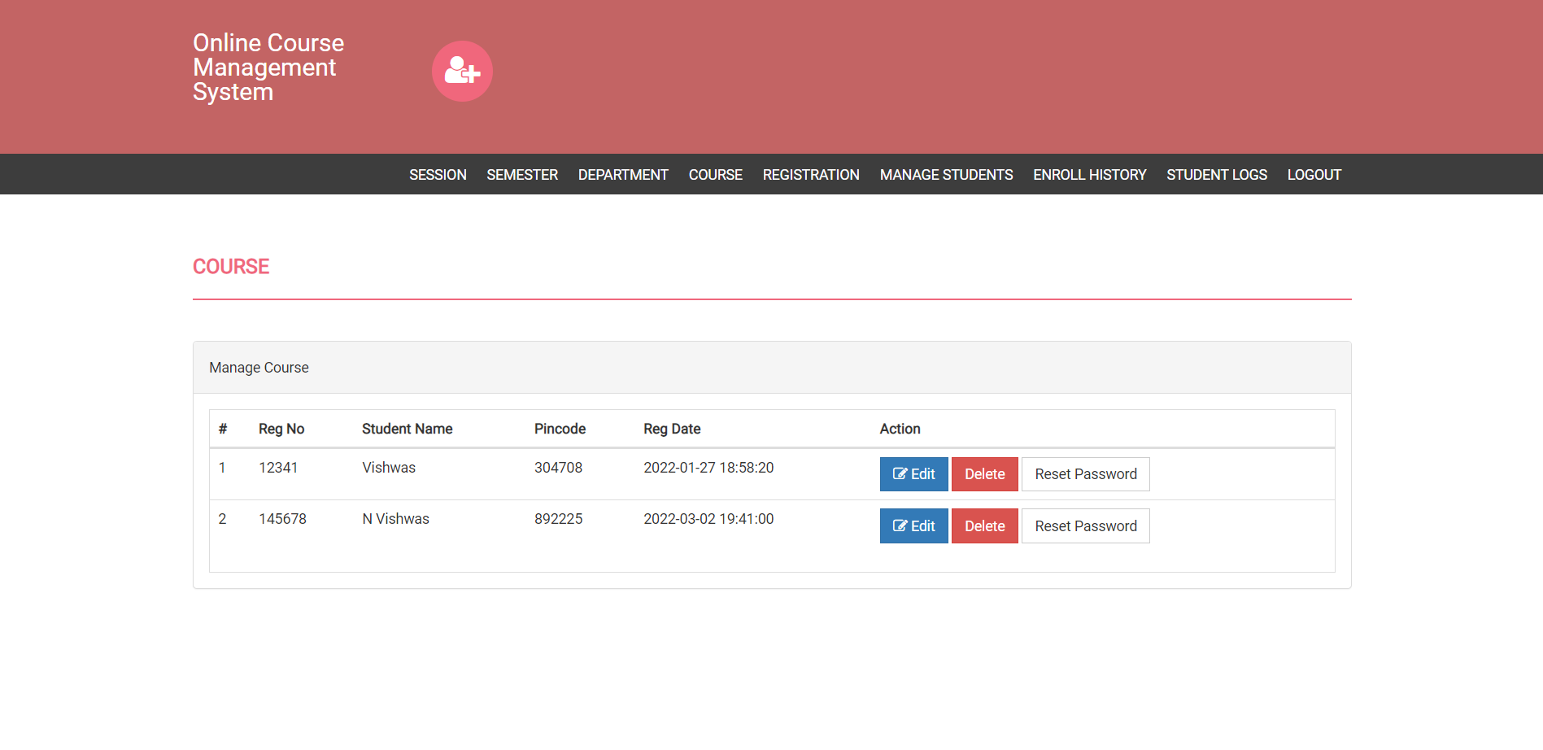
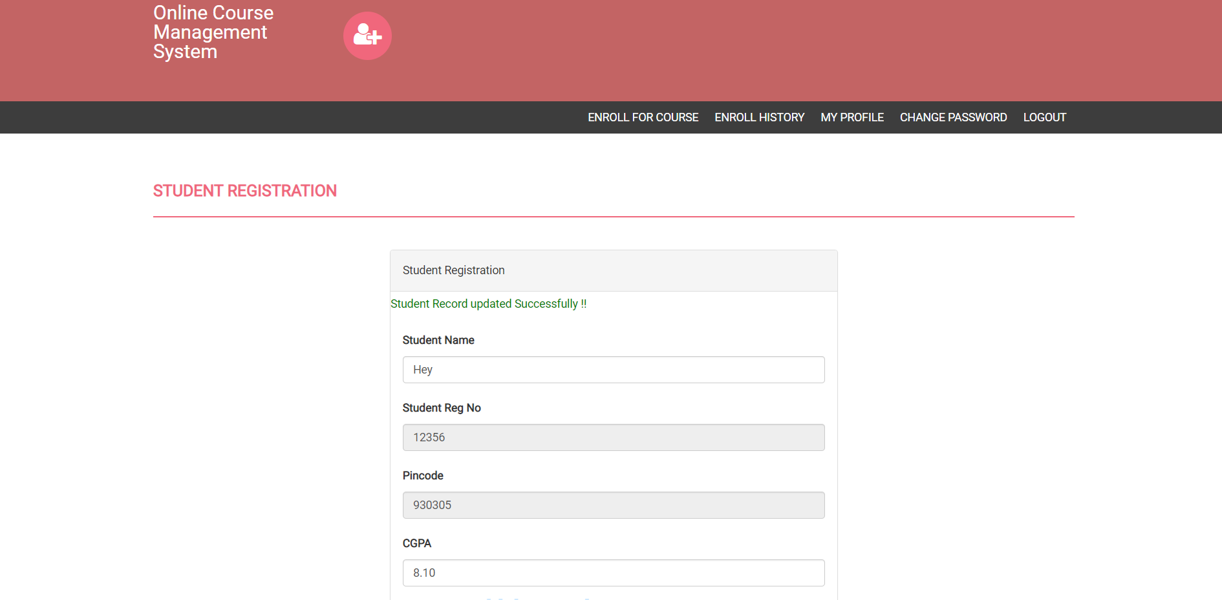
Work Carried out

Slide 14
Work Carried out
In conclusion, Online Course Management System is a functional application. Users can view, enroll, and access their courses. It also allows the admin to manage the courses , semesters and intervals to add service. If the service is complete the admin can remove the courses. We have used MySQL in our project as it is an ideal choice if you have structured data which is high correlated.

Slide 15
CONCLUSION
Once the on-boarding and training phase wraps up, the new staff member should be ready to engage in a rewarding long-lasting career. The full cycle recruiting process can indeed be a grueling experience for all parties involved. But, will the addition of a new, reliable employee for the firm, it is also a much needed and appreciated part of nurturing a successful business.
Even for owners of small enterprises, for peace of mind in hiring the best candidate for a job, following the steps of the recruitment life cycle is well worth the time and effort and is a proven method of reducing turnovers within a company, saving both time and money in the long run.

Slide 16
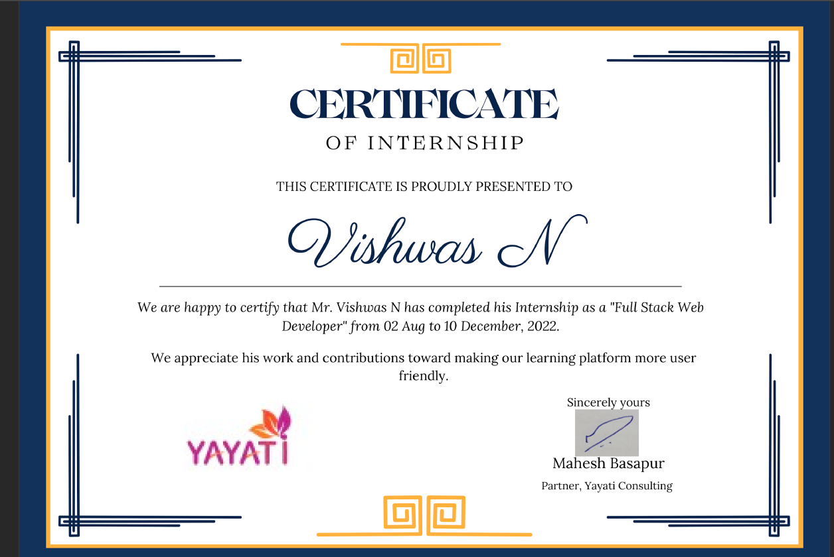
CERTIFICATE

Slide 17

s
Thank you

